Slide 1


TRPO 置信域策略优化 第二部分
东川路第一可爱猫猫虫

Slide 2

主要内容
感谢
蕾西亚万岁啊我透
的续费包月充电
$∇_{θ}L_{θ_{old}}\left(θ_{old}\right)$的实现
用KKT条件求解不等式约束的优化问题
Hessian Vector Product
共轭梯度法求Hx=g
回溯线搜索

Slide 3
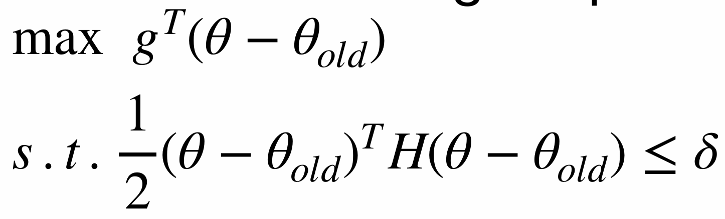
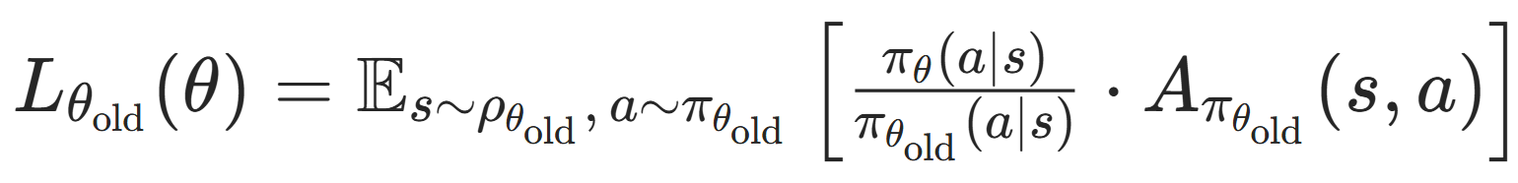
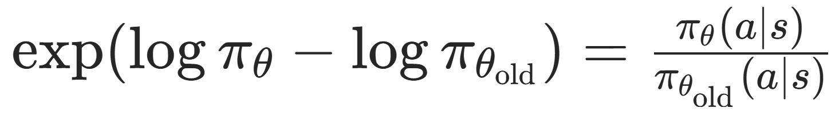
Policy Net
g是$∇_{θ}L_{θ_{old}}\left(θ_{old}\right)$
log_probs = policy_net.get_log_prob(states, actions)
ratio = torch.exp(log_probs - old_log_probs)

Slide 4


$g^{T}$
loss = (ratio * advantages).mean()
g是$∇_{θ}L_{θ_{old}}\left(θ_{old}\right)$，下一步对$L_{θ_{old}}\left(θ\right)$求导
loss_grads = autograd.grad(loss, policy_net.parameters())
把梯度张量展平成一维张量，拼接得到$g^{T}$
loss_grad = torch.cat([grad.view(-1) for grad in loss_grads]).detach()

Slide 5
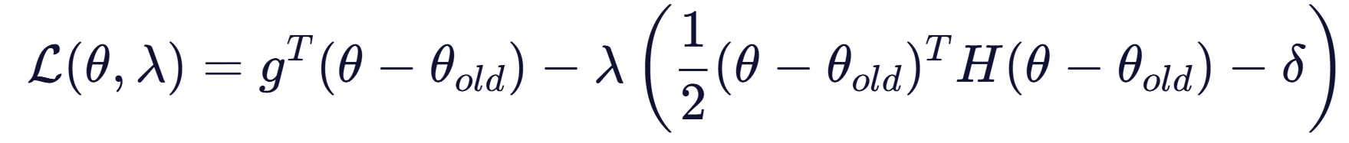
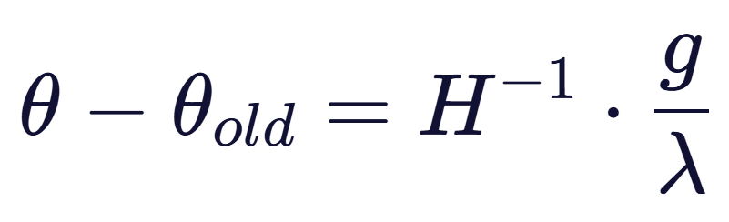
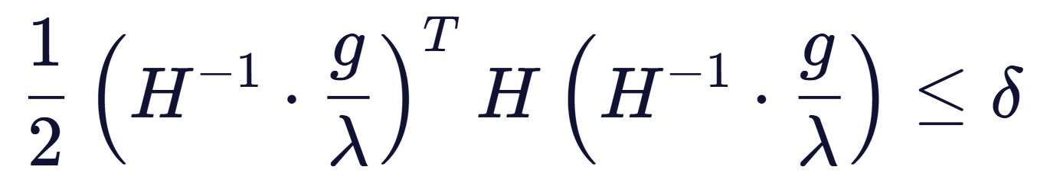
求解不等式约束的优化问题
对$θ$求偏导并置为0
将$θ−θ_{old}$的表达式带入约束条件

Slide 6
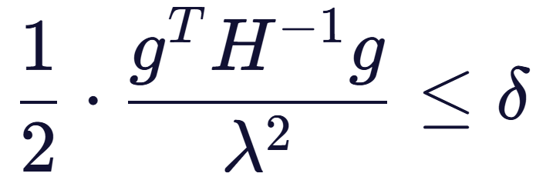
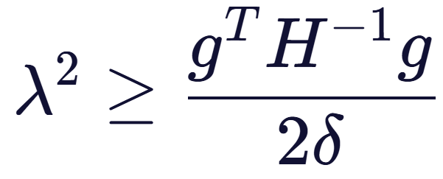
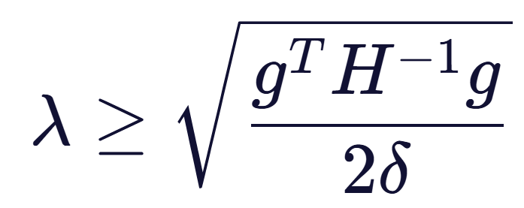
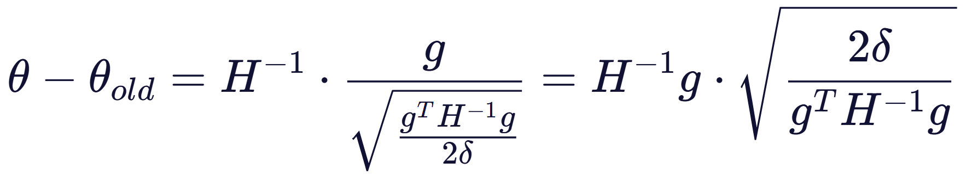


先求$H^{−1}g$
思路是先求$H^{−1}g$
即求解Hx=g
H是平均KL散度的Hessian矩阵
共轭梯度法

Slide 7

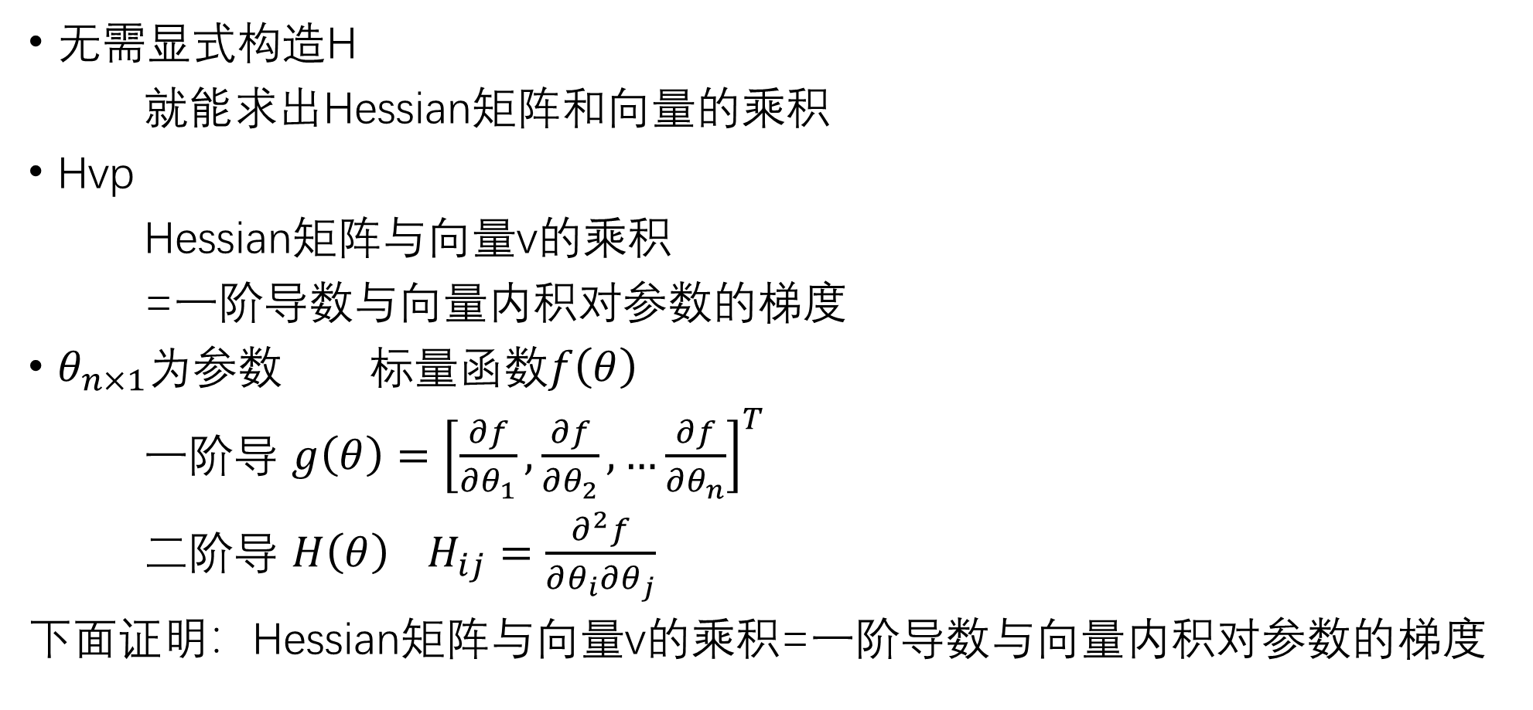
Hessian Vector Product
无需显式构造H
就能求出Hessian矩阵和向量的乘积
Hvp
Hessian矩阵与向量v的乘积
=一阶导数与向量内积对参数的梯度
$θ_{n×1}$为参数 标量函数$f\left(θ\right)$
一阶导 $g\left(θ\right)={\left[\frac{∂f}{∂θ_{1}},\frac{∂f}{∂θ_{2}},…\frac{∂f}{∂θ_{n}}\right]}^{T}$
二阶导 $H\left(θ\right)$ $H_{ij}=\frac{∂^{2}f}{∂θ_{i}∂θ_{j}}$
下面证明：Hessian矩阵与向量v的乘积=一阶导数与向量内积对参数的梯度

Slide 8
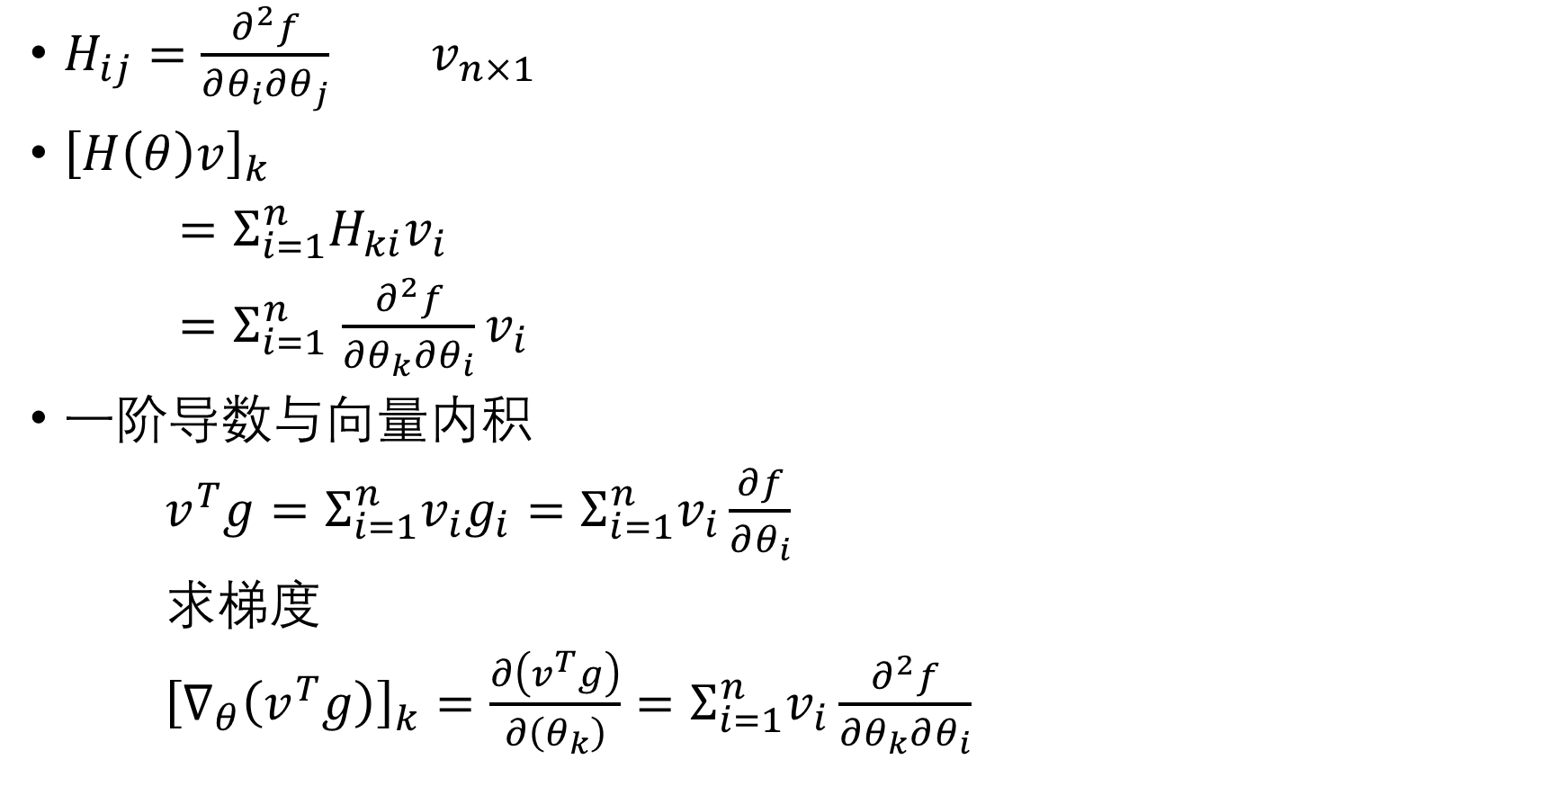
Hessian矩阵与向量v的乘积 =一阶导数与向量内积对参数的梯度
$H_{ij}=\frac{∂^{2}f}{∂θ_{i}∂θ_{j}}$ $v_{n×1}$
${\left[H\left(θ\right)v\right]}_{k}$
$=Σ_{i=1}^{n}H_{ki}v_{i}$
$=Σ_{i=1}^{n}$ $\frac{∂^{2}f}{∂θ_{k}∂θ_{i}}v_{i}$
一阶导数与向量内积
$v^{T}g=Σ_{i=1}^{n}v_{i}g_{i}=Σ_{i=1}^{n}v_{i}\frac{∂f}{∂θ_{i}}$
求梯度
${\left[∇_{θ}\left(v^{T}g\right)\right]}_{k}=\frac{∂\left(v^{T}g\right)}{∂\left(θ_{k}\right)}=Σ_{i=1}^{n}v_{i}\frac{∂^{2}f}{∂θ_{k}∂θ_{i}}$

Slide 9
Hvp应用于TRPO 求Hv
DeepRL_Algorithms/Algorithms/pytorch/TRPO at master · RITCHIEHuang/DeepRL_Algorithms · GitHub
$f\left(θ\right)$是KL散度的均值
kl = policy_net.get_kl(states)
kl = kl.mean()
求$f\left(θ\right)$的一阶导数
grads = torch.autograd.grad(kl, policy_net.parameters(), create_graph=True)
flat_grad_kl = torch.cat([grad.view(-1) for grad in grads])
一阶导数与向量相乘得到内积
kl_v = (flat_grad_kl * v).sum()
内积对参数求梯度
grads = torch.autograd.grad(kl_v, policy_net.parameters())
flat_grad_grad_kl = torch.cat([grad.contiguous().view(-1) for grad in grads]).detach()

Slide 10

Hvp
def Hvp(v):
kl = policy_net.get_kl(states)
kl = kl.mean()
grads = torch.autograd.grad(kl, policy_net.parameters(), create_graph=True)
flat_grad_kl = torch.cat([grad.view(-1) for grad in grads])
kl_v = (flat_grad_kl * v).sum()
grads = torch.autograd.grad(kl_v, policy_net.parameters())
flat_grad_grad_kl = torch.cat([grad.contiguous().view(-1) for grad in grads]).detach()
return flat_grad_grad_kl + v * damping

Slide 11
共轭梯度 Ax=b
初始化
x = torch.zeros_like(b, device=device)
r = - b.clone()
p = b.clone()
rdotr = r.t() @ r

Slide 12
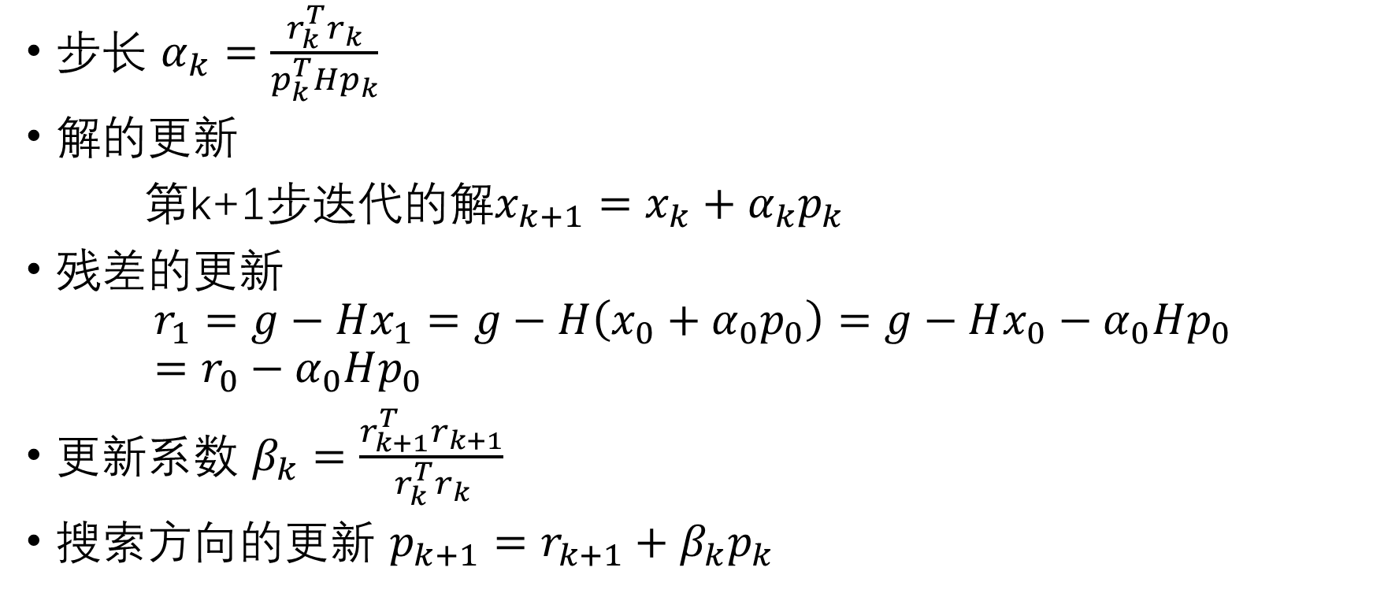
迭代
步长 $α_{k}=\frac{r_{k}^{T}r_{k}}{p_{k}^{T}Hp_{k}}$
解的更新
第k+1步迭代的解$x_{k+1}=x_{k}+α_{k}p_{k}$
残差的更新
$$r_{1}=g−Hx_{1}=g−H\left(x_{0}+α_{0}p_{0}\right)=g−Hx_{0}−α_{0}Hp_{0}=r_{0}−α_{0}Hp_{0}$$
更新系数 $β_{k}=$ $\frac{r_{k+1}^{T}r_{k+1}}{r_{k}^{T}r_{k}}$
搜索方向的更新 $p_{k+1}=r_{k+1}+β_{k}p_{k}$

Slide 13

迭代代码
for i in range(steps):
Hvp = Hvp_f(p) # A @ p
alpha = rdotr / (p.t() @ Hvp) # step length
x += alpha * p # update x
r += alpha * Hvp # new residual
new_rdotr = r.t() @ r
betta = new_rdotr / rdotr # beta
p = - r + betta * p
rdotr = new_rdotr
if rdotr < rdotr_tol: # satisfy the threshold
break

Slide 14
完整的CG共轭梯度函数
def conjugate_gradient(Hvp_f, b, steps=10, rdotr_tol=1e-10):
x = torch.zeros_like(b, device=device) # initialization approximation of x
r = - b.clone() # Hvp(x) - b : residual
p = b.clone() # b - Hvp(x) : steepest descent direction
rdotr = r.t() @ r # r.T @ r
for i in range(steps):
Hvp = Hvp_f(p) # A @ p
alpha = rdotr / (p.t() @ Hvp) # step length
x += alpha * p # update x
r += alpha * Hvp # new residual
new_rdotr = r.t() @ r
betta = new_rdotr / rdotr # beta
p = - r + betta * p
rdotr = new_rdotr
if rdotr < rdotr_tol: # satisfy the threshold
break
return x

Slide 15

求参数的完整更新方向
step_dir = conjugate_gradient(Hvp, loss_grad)
shs = Hvp(step_dir).t() @ step_dir
lm = torch.sqrt(2 * max_kl / shs)
参数的完整更新方向
step = lm * step_dir

Slide 16
回溯线搜索
def line_search(model, f, x, step_dir, expected_improve, max_backtracks=10, accept_ratio=0.1):
f_val = f(False).item()
for step_coefficient in [.5 ** k for k in range(max_backtracks)]:
x_new = x + step_coefficient * step_dir
set_flat_params(model, x_new)
f_val_new = f(False).item()
actual_improve = f_val_new - f_val
improve = expected_improve * step_coefficient
ratio = actual_improve / improve
if ratio > accept_ratio:
return True, x_new
return False, x

